Slide 1
The Rainbow Universe
Mindy Townsend
Cassie Hatcher
Notes:
Don’t explain the image

Slide 2
What color is the Sun?
Notes:
Give the girls time to answer.

Slide 3
The Sun is many different colors!
Notes:
The sun is many different colors, but emits most of it’s light in the yellow/green portion of the rainbow. But if we use special filters, we can

Slide 4
Spectroscopy
The technique of splitting light into all it’s different wavelengths
Notes:
We can go one step further than just taking images through different filters. We can use tools like a prism or a diffraction grating to spread light out into all its different wavelengths. Let girls play with diffraction gratings here.

Slide 5
Composition of Stars
Notes:
Spectroscopy is how we tell the chemical composition of stars. Many (but not all) stars have an atmosphere, or a cloud of gas surrounding them. If this atmosphere is missing, we will see a pure rainbow, just like if you look at an old-fashioned light bulb. However, if the star has an atmosphere (like the Sun), we sill see some missing wavelengths of light, due to different atoms absorbing those particular wavelengths. If we look at a hot gas, we can see an emission line spectrum, where that gas is emitting light at certain wavelength.

Slide 6
Chemical “Fingerprints”
Each element has it’s own unique spectrum!
Spectroscopy is how astronomers learn what stars are made of
Notes:
We are going to play around with detecting different types of elements that we see in space.

Slide 7
Spectrum lab

Slide 8
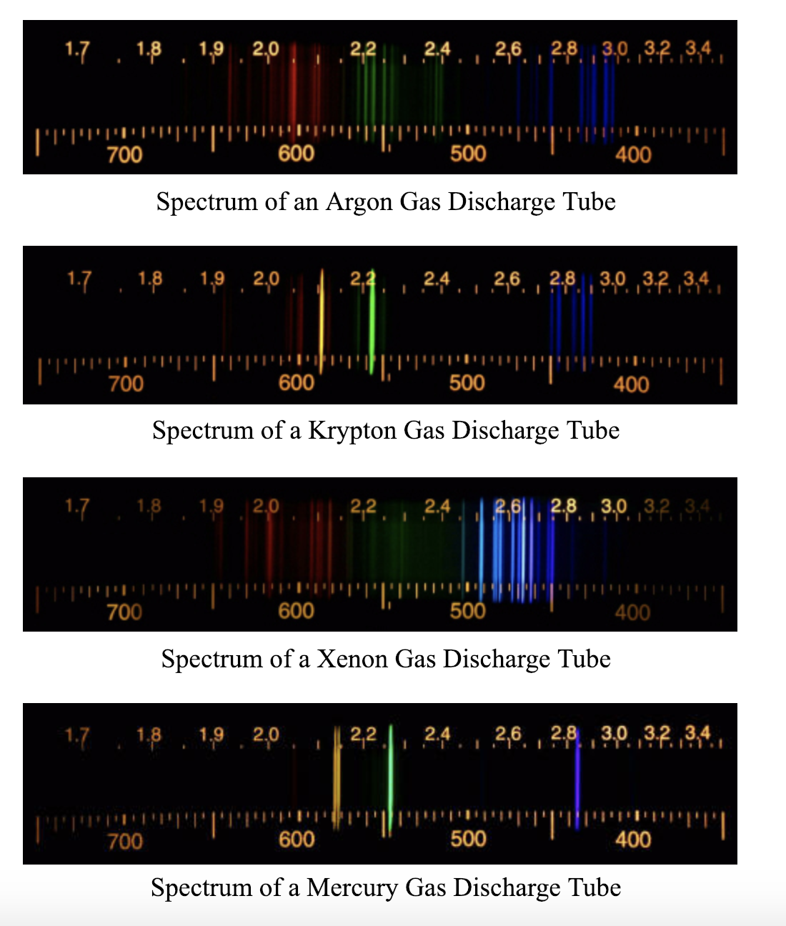
What did you see?

Slide 9
The Sun
If we look at the Sun, this is what we see
Notes:
Actually it’s even more complicated than this! Let’s take a look.

Slide 10
Notes:
It’s complicated because the sun has a lot of atmosphere! These fuzzy lines are caused by molecules. And, we can use this spectrum to learn the temperature of the Sun, which is 10,000 degrees farenheit!

Slide 11
Stars of Different Sizes
Notes:
Stars of different sizes and temperatures have different spectra. What kind of differences do you notice?

Slide 12
Classifying Stars
This is a picture of the women who were the first classifiers of stars!
Notes:
n 1881, Edward Charles Pickering, director of the Harvard Observatory, had a problem: the volume of data coming into his observatory was exceeding his staff’s ability to analyze it. He also had doubts about his staff’s competence–especially that of his assistant, who Pickering dubbed inefficient at cataloging. So he fired his male assistant and replaced him with his maid, Williamina Fleming.... One of Pickering’s computers, however, would stand out for her contribution to astronomy: Annie Jump Cannon, who devised a system for classifying stars that is still used today.

