Slide 1
Distribution of Molecular Clouds: CO ;
Notes:
Whirlpool galaxy. Blue is CO. Let’s contemplate this picture. All the dust is the dark spots—that’s the interstellar medium. The denser gas are the molecular clouds—the sites of star formation. Star formation does not happen everywhere in a galaxy!

Slide 2
Far-IR/Submillimeter: Pokhrel et al. 2018
Telescopes: Herschel,
James Clerk Maxwell Telescope,
Very Large Array
Notes:
Inside the clumps, we observe elongated gaseous filaments, and inside filaments are cores, which are where new stars are able to form.
Let’s pause and think about the distances. What is 1 AU? So are protostellar objects big? Do you think that is all a star?

Slide 3
Herschel far-IR telescope
Pokhrel et al. (2015)

Slide 4
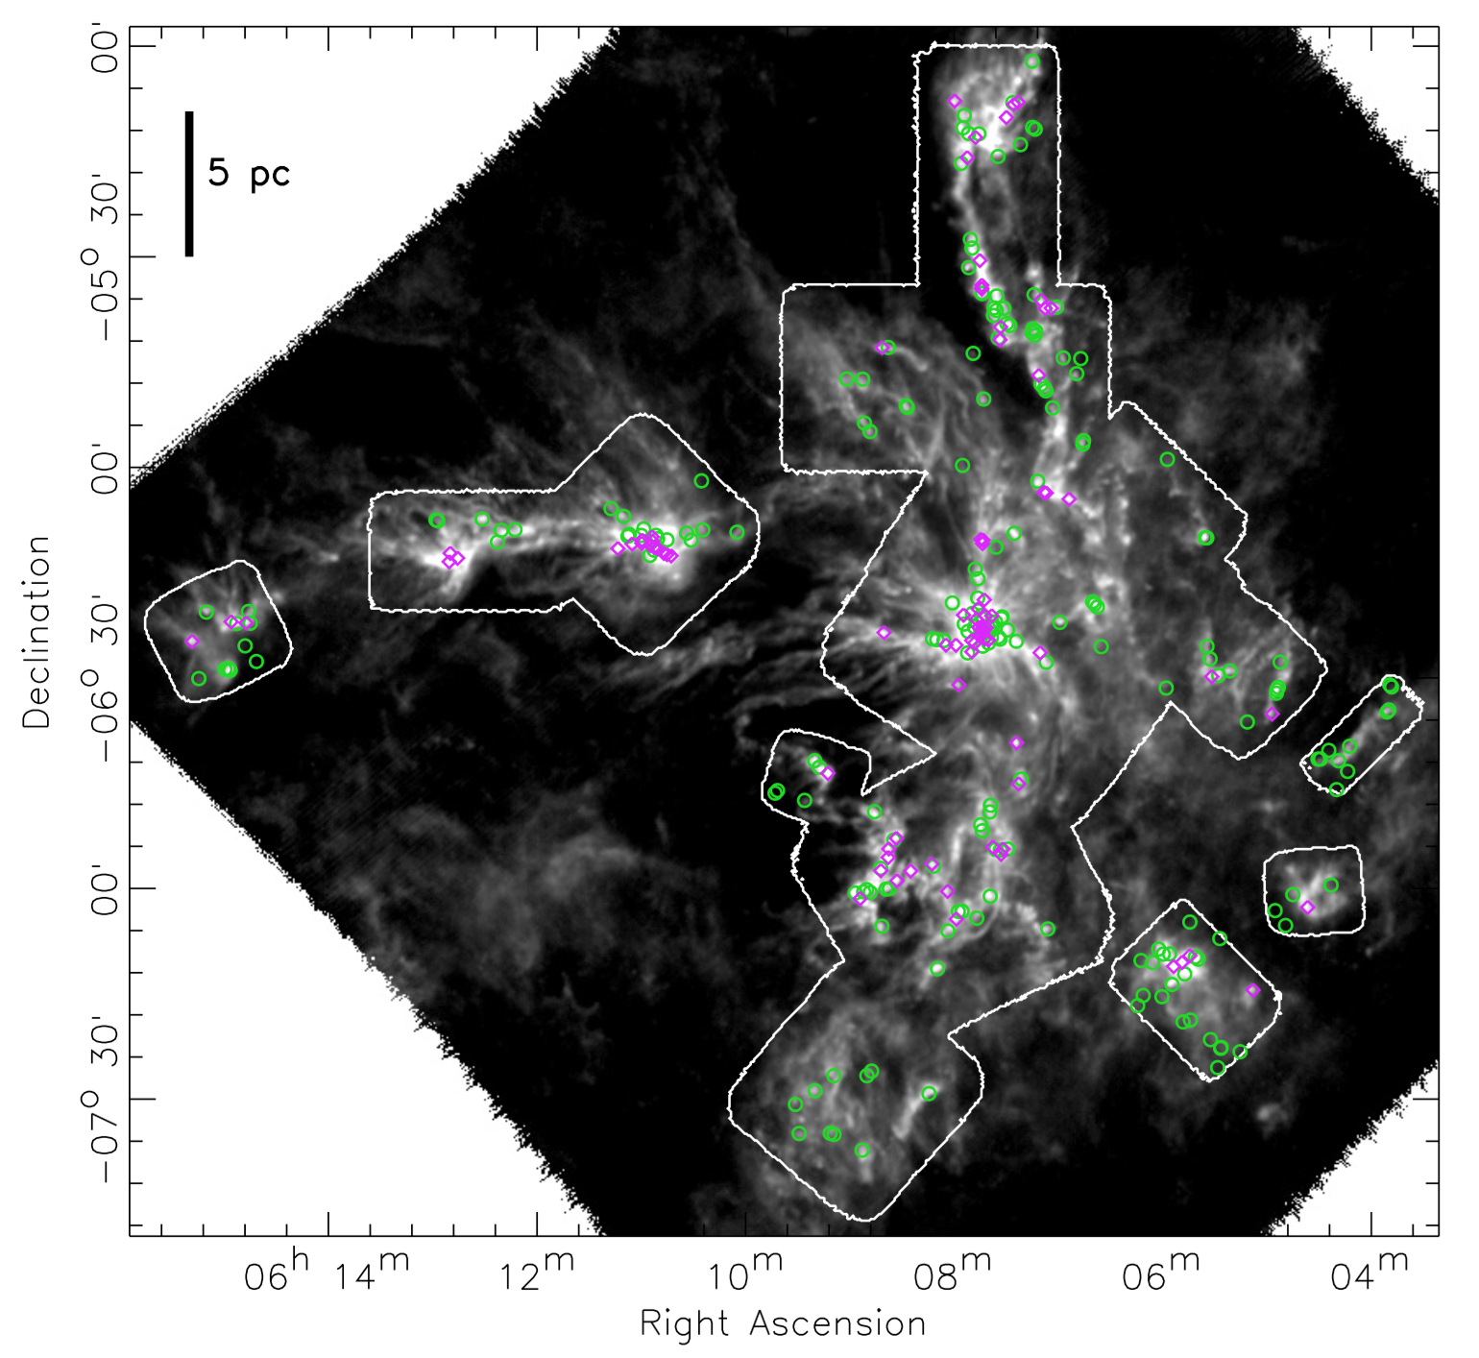
Notes:
Circles identify cores, which you are going to do on the worksheet. Astronomers then relate the amount of gas to the number of stars formed.

